Slide 1

Predicting MLB Player Performance
Mike Ogrysko
May 2023

Slide 2
Project Motivation
MLB nearing $11 billion in gross revenues (Brown, 2022)
Average value of a team is $2 billion (Ozanian & Teitelbaum, 2022)
Team payrolls range from $61 million to $282 million (Spotrac, 2022)
Reliance on data and analytics for on-field product
Teams generate metrics to project player performance to create rosters

Slide 3
Research Areas
Estimated peak player age at each position
Binary classification to determine players that will exceed their 2022 performance
Evaluation of two regression models to predict future performance

Slide 4
Measuring Player Performance
Wins Above Replacement (WAR)
Number of team wins that a player represents when compared to a replacement player at the same position
Quality of Player | WAR
MVP Material | 8 or higher
Superstar | 6-8
All-Star | 4-6
Solid Regular | 2-4
Role Player | 1-2
Bench Material | 0-1
Triple A Material | 0 or below
Example:
Team of only minor league players estimated to win 48 games
Player from the team replaced with a free agent and team wins jump to 54
New player’s WAR is 6
A Fan’s Guide to Baseball Analytics (pp. 189-191) by A. Castrovince, 2020.

Slide 5
Data and Research Platform
Data compiled from Stathead Baseball (https://stathead.com/baseball/) and FanGraphs (https://www.fangraphs.com/) from 1980 onwards
Exported as a series of CSV files -> merged -> cleaned -> transformed using Python in Jupyter Notebooks
Python used for identifying peak age at each position and binary classification
Libraries used included: Pandas, Numpy, Matplotlib, Seaborn, and Sklearn
R used for evaluation of multiple linear and lasso regressions

Slide 6
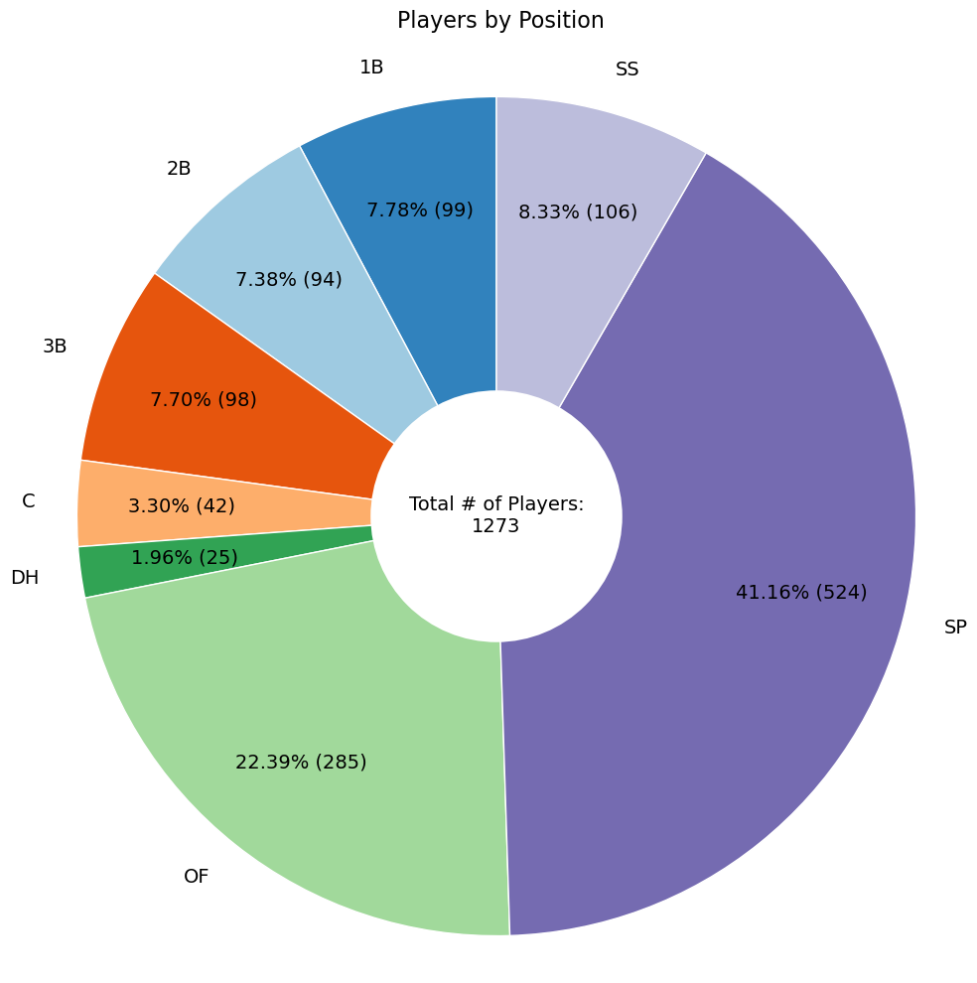
Estimated Peak Player Ages by Position
Player data from 1980 to present:
Regular season only
Played specific position for at least 51% of games (positional players)
Plate appearances are greater than or equal to 500 (positional players)
Started 60% of games pitched in (starting pitchers)
Started at least 20 games (starting pitchers)
5627 seasons for positional players and 3800 seasons for starting pitchers
Season data for players who played 3 or more seasons at their positions

Slide 7
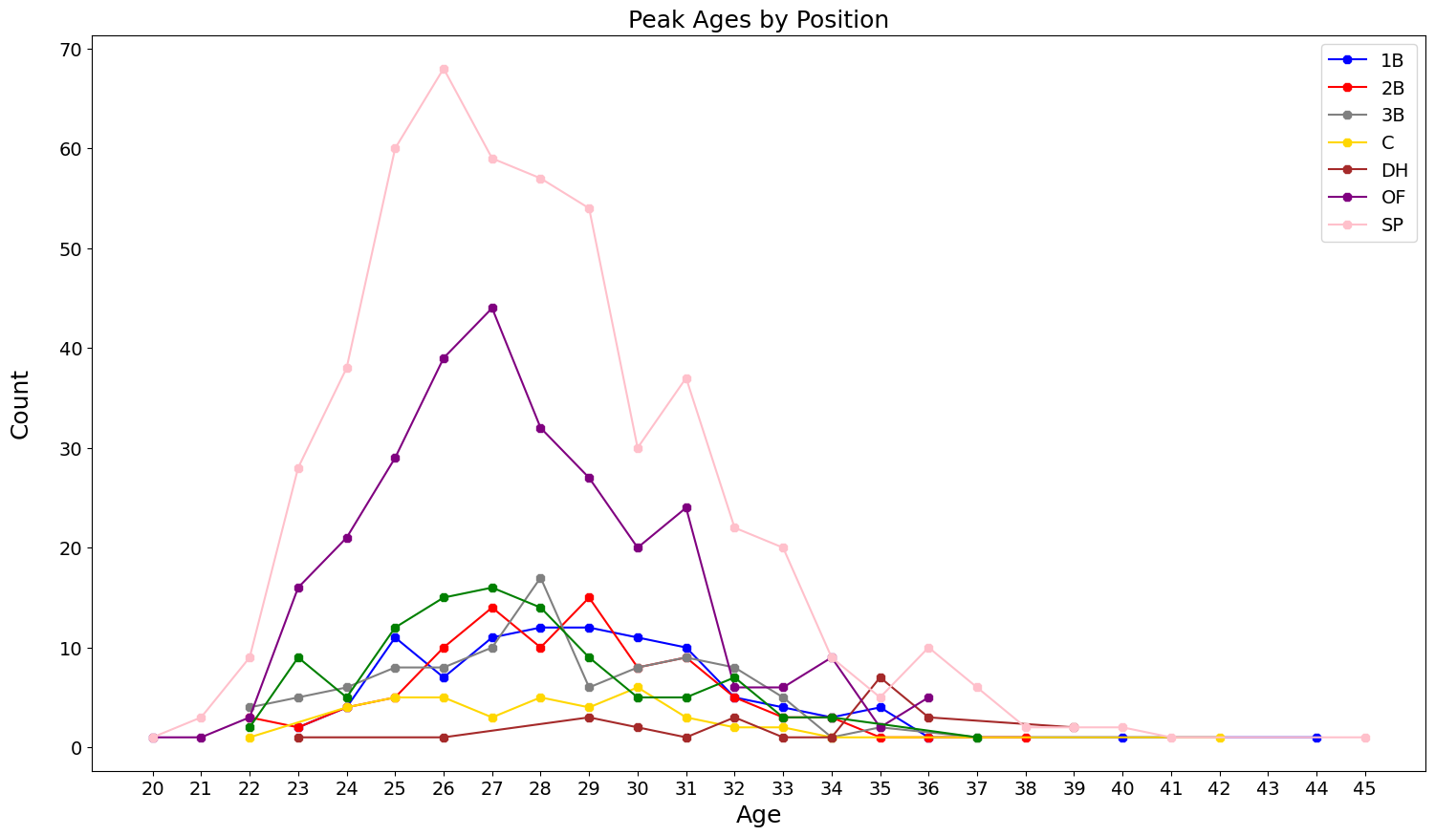
Results: Estimated Peak Player Age
Position | Player Age
Outfield | 27
First Base | 29
Second Base | 29
Shortstop | 27
Third Base | 28
Catcher | 30
Designated Hitter | 35
Starting Pitcher | 26

Slide 8
Players Exceeding 2022 WAR
Individual player seasons
Basic statistics: batting average, home runs, stolen bases, etc.
Advanced statistics: WAR, wOBA, wRC, etc.
Engineered features
Player peak age season
Batters: 12,224 training records, 120 features -> 62
Pitchers: 4,678 training records, 148 features -> 68
Random Forest algorithm for binary classification

Slide 9
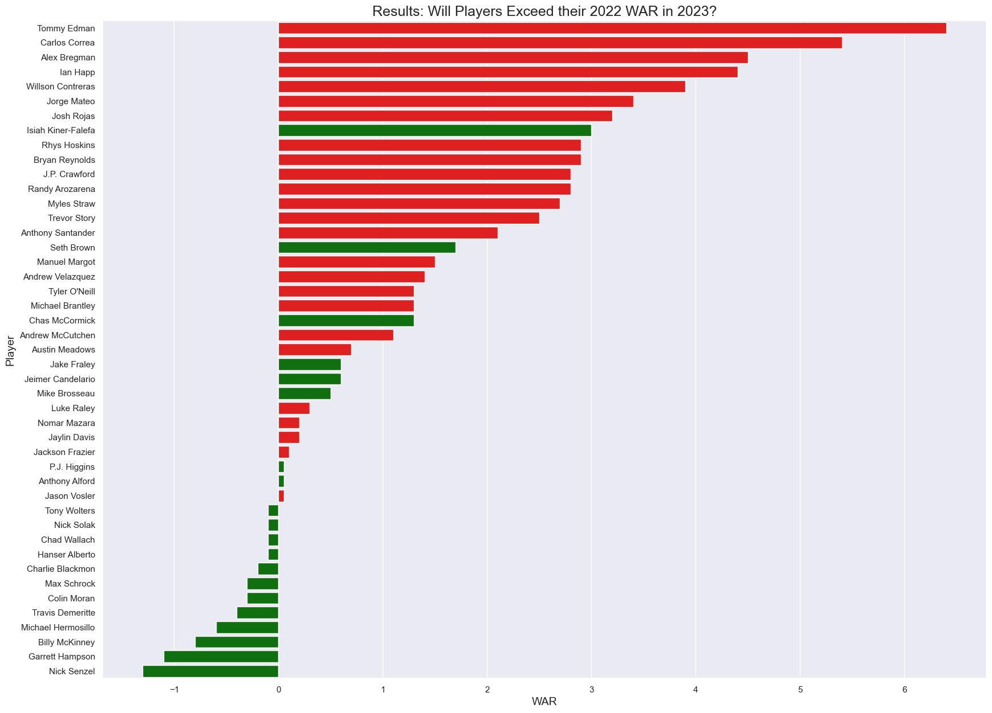
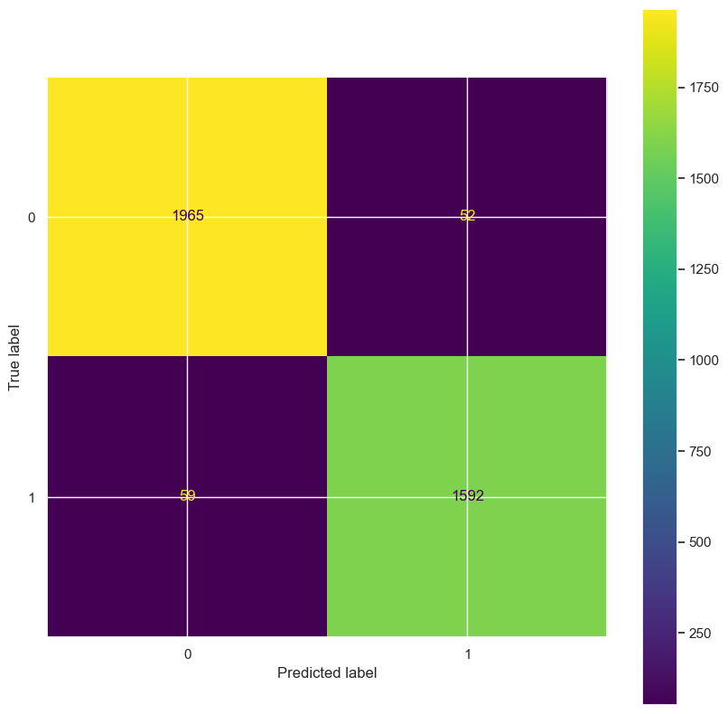
Results: Players Exceeding 2022 WAR - Batters

Slide 10
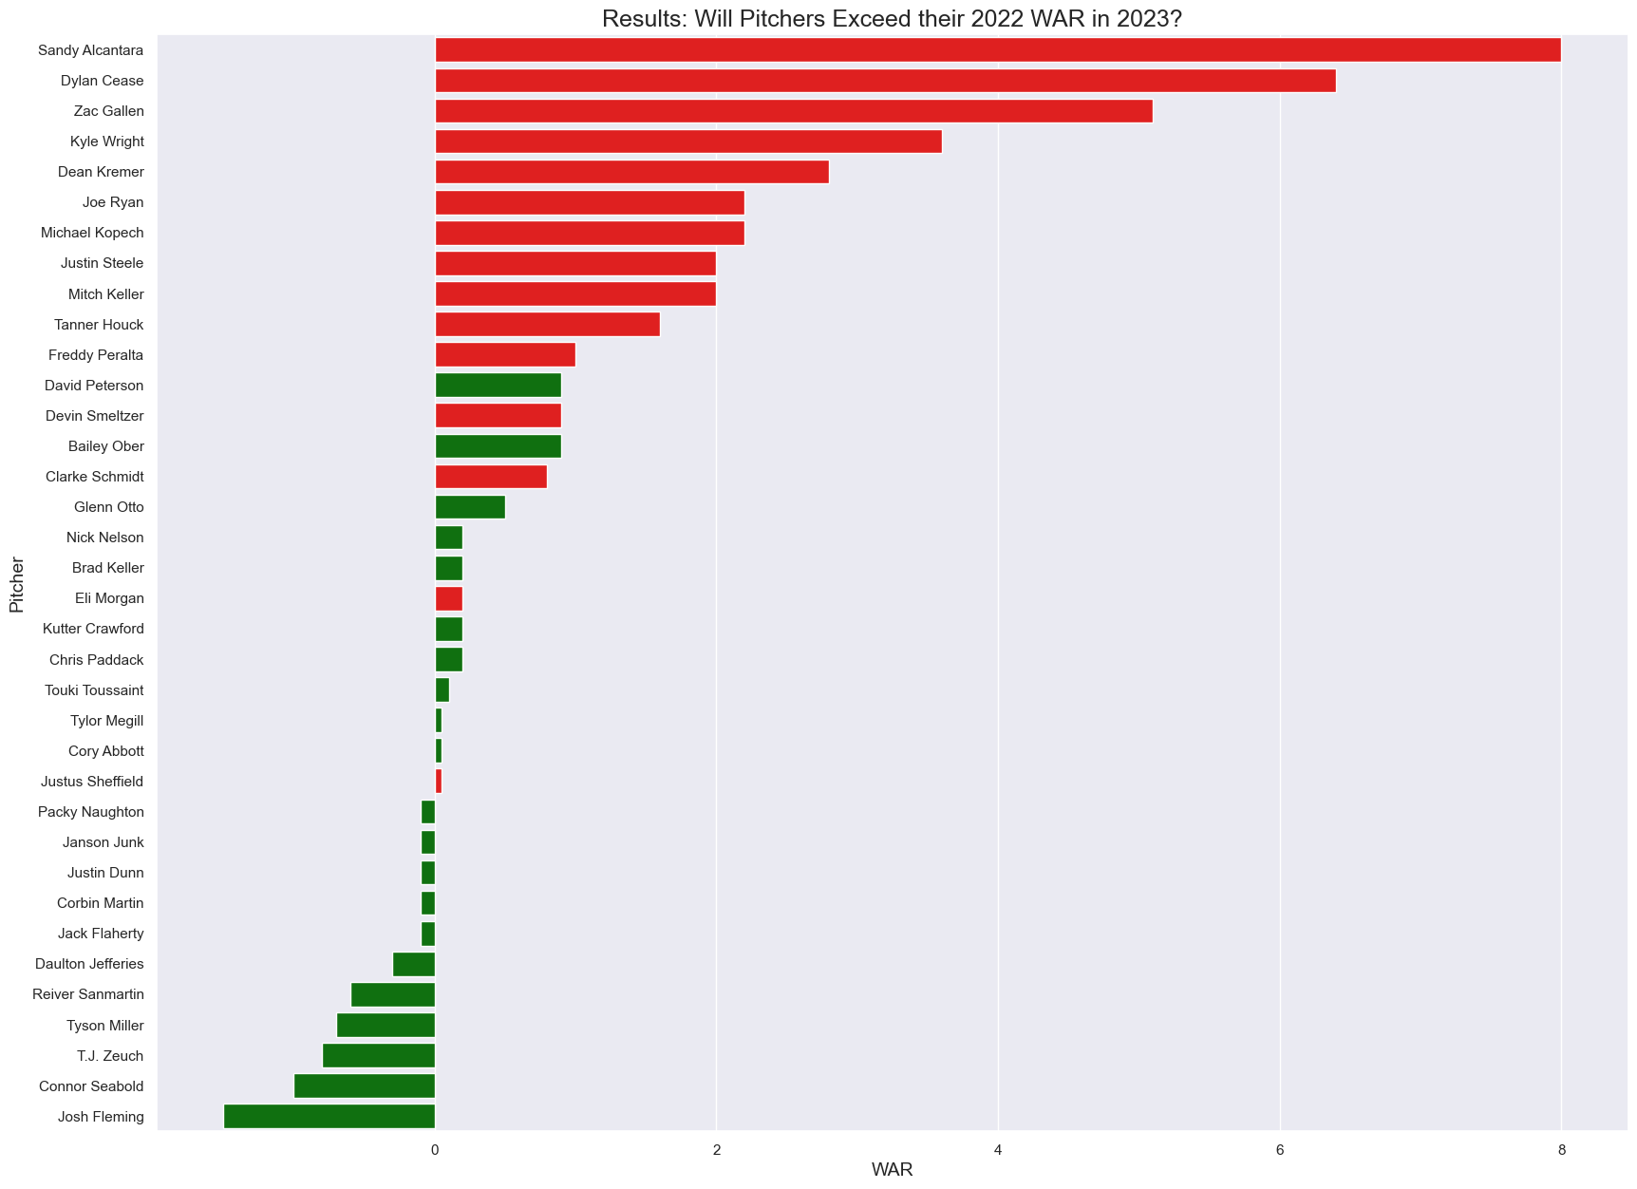
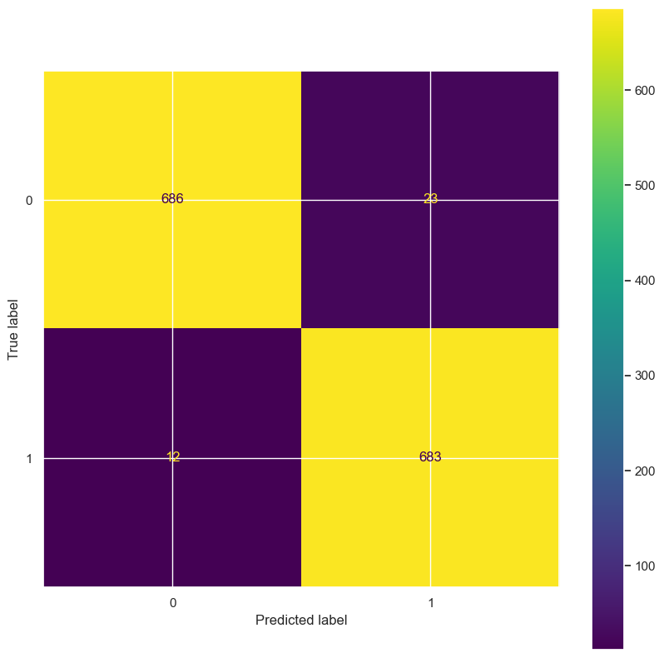
Results: Players Exceeding 2022 WAR - Pitchers

Slide 11
Evaluating Regression Models to Predict 2023 WAR
Subset of 37 of the dataset’s features
14,768 individual player seasons for training
Multiple linear regression and lasso regression

Slide 12
Results: Evaluating Regression Models to Predict 2023 WAR
All-Subsets Multiple Linear Regression | Lasso Regression
Uses 9 features | Uses 28 features
Age -0.1378358 X1B -0.0031971 SB 0.0085434 BB 0.0035137 Max_WAR 0.3448804 Max_WAR_Age 0.0836675 Pos_Cat -0.0258308 Prev_WAR_Class 0.1121132 war_season 0.3154692 | Age -1.377544e-01 Team 1.106992e-03 Lg -8.136508e-02 G -1.991968e-03 R 3.345554e-03 X1B -5.489239e-03 X3B 1.599239e-02 SB 7.535503e-03 CS 4.175393e-03 BB 3.081557e-03 SO -2.425328e-03 OPS+ -2.624548e-05 GIDP 7.257722e-03 HBP -3.519761e-03 | SH -9.377933e-03 SF -2.977418e-03 IBB 3.179217e-03 Prev_WAR 2.326947e-02 Max_WAR 3.420188e-01 Max_WAR_Age 8.169166e-02 Pos_Cat -3.040163e-02 Season_WAR_Class 9.620339e-02 Prev_WAR_Class 8.085892e-02 Team_WL -1.962469e-02 Games_played 5.270588e-01 war_season 1.837680e-01 player_season 1.019062e-06 war_corr 3.289656e-01
Adjusted R²: 0.5067 | R²: 0.5099058

Slide 13
Summary
Peak ages differ by position; range from 26 to 30 with DH as the outlier
Binary classification – 20/45 batters and 21/36 pitchers predicted to exceed 2022 WAR in 2023
Random Forest algorithm 97% & 98% accuracies on classification
Lasso regression R² exceeded Multiple Linear Regression for predicting 2023 WAR
Explaining 50.99058% of the variation of the response values of the training data
Lasso regression could be a good starting point for building a model to predict WAR

Slide 14

Thank you!

Slide 15
References
Brown, M. (2022, Apr 7). How Major League Baseball could crack $11 billion in revenues in 2022. Forbes. https://www.forbes.com/sites/maurybrown/2022/04/07/how-major-league- baseball-could-crack-11-billion-in-revenues-in-2022/?sh=68098b77f63a
Castrovince, A. (2020). A fan’s guide to baseball analytics. Sports Publishing.
Ozanian, M. & Teitelbaum, J. (2022, Mar 24). Baseball’s most valuable teams 2022: Yankees hit $6 billion as new CBA creates new revenue streams. Forbes. https://www.forbes.com/sites/mikeozanian/2022/03/24/baseballs-most-valuable-teams-2022-yankees-hit-6-billion-as-new-cba-creates-new-revenue-streams/?sh=244684d600a2
Spotrac. (2022). MLB team payroll tracker. https://www.spotrac.com/mlb/payroll/2022/?ref=trending-pages
Presentation images: Getty Images/Ringer illustration

